Slide 1
Secure Data Hiding in Image Using Steganography
CAPSTONE PROJECT
Presented By:
Student Name : Ankem Yuva Naga Durga Abhishek
College Name & Department : Chalapathi Institute Of Technology
&
Department Of Computer Science and Engineering

Slide 2
OUTLINE
Problem Statement
Technology used
Wow factor
End users
Result
Conclusion
Git-hub Link
Future scope

Slide 3
Problem Statement
In today’s digital world, where data breaches and cyber threats are growing at an alarming rate, the need for secure and inconspicuous communication has never been more crucial. Traditional encryption methods, while effective, often attract unwanted attention, making encrypted messages obvious targets for interception. This project addresses the challenge of covertly transmitting sensitive information by using steganography—an advanced technique that hides data within digital images. By embedding confidential messages into the least significant bits of an image’s pixel data, we ensure the information remains invisible to the naked eye while maintaining the image’s original appearance. This innovative approach enhances data security and privacy, making the hidden communication undetectable and highly secure.

Slide 4
Technology used
Programming Language: Python
Steganography Technique: Least Significant Bit (LSB)
Libraries: Tkinter (for GUI), PIL (Python Imaging Library), Stegano (LSB Steganography), OpenCV, NumPy
Development Tools: Jupyter Notebook, VS Code

Slide 5
Wow factors
Invisible Security: The embedded data remains imperceptible to the human eye, providing an added layer of security.
User-Friendly Interface: A GUI enables easy encoding and decoding of hidden messages without requiring deep technical expertise.
Efficiency: The LSB method ensures minimal distortion of the image while maximizing data capacity.
Real-Time Application: This approach can be applied in confidential communication, watermarking, and digital rights management.
Interactive Features: Implemented interactive buttons for opening images, encoding messages, and decoding messages directly from the GUI.

Slide 6
End users
Cybersecurity professionals
Government and defense agencies
Journalists and whistleblowers requiring discreet communication
Organizations dealing with sensitive data
Educational institutions for research and training in secure communication

Slide 7
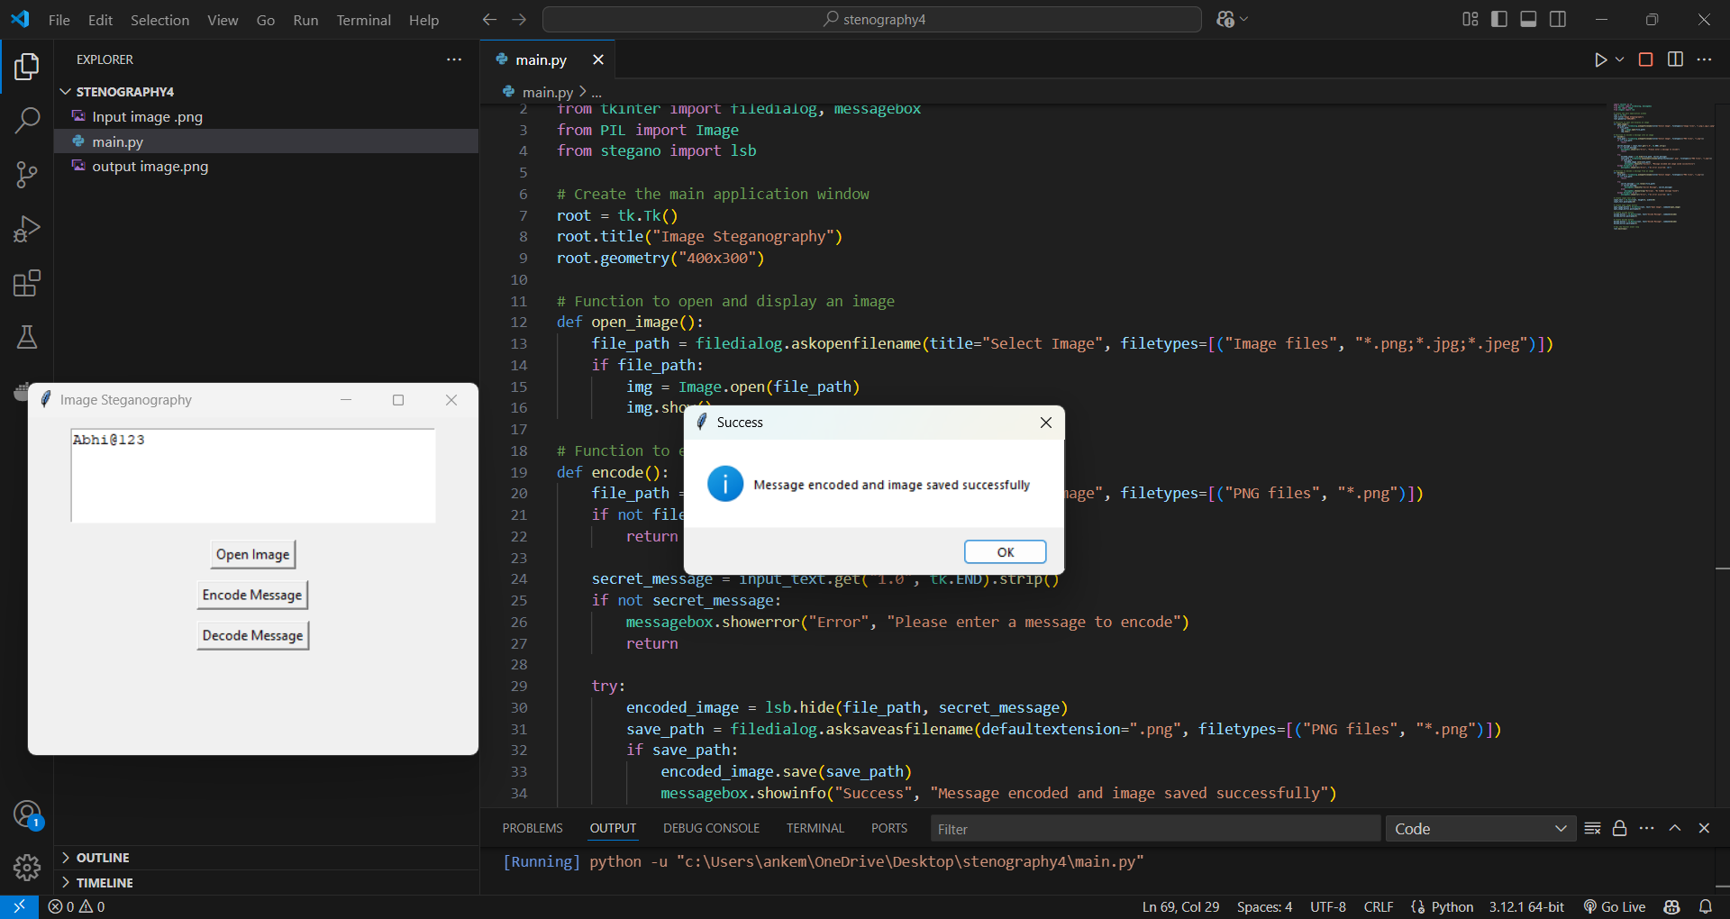
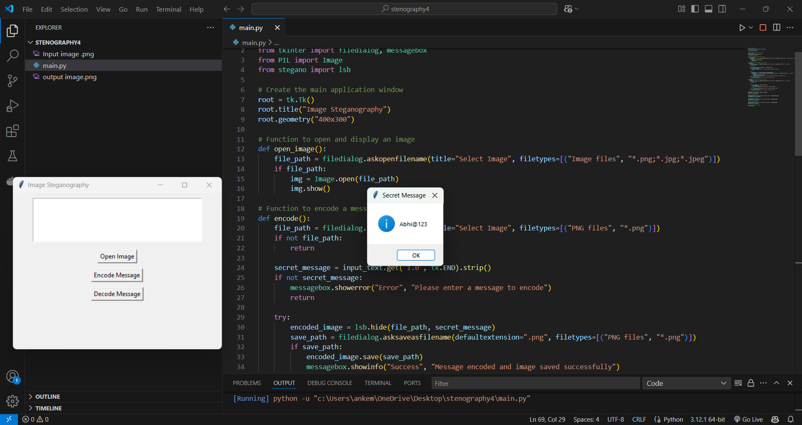
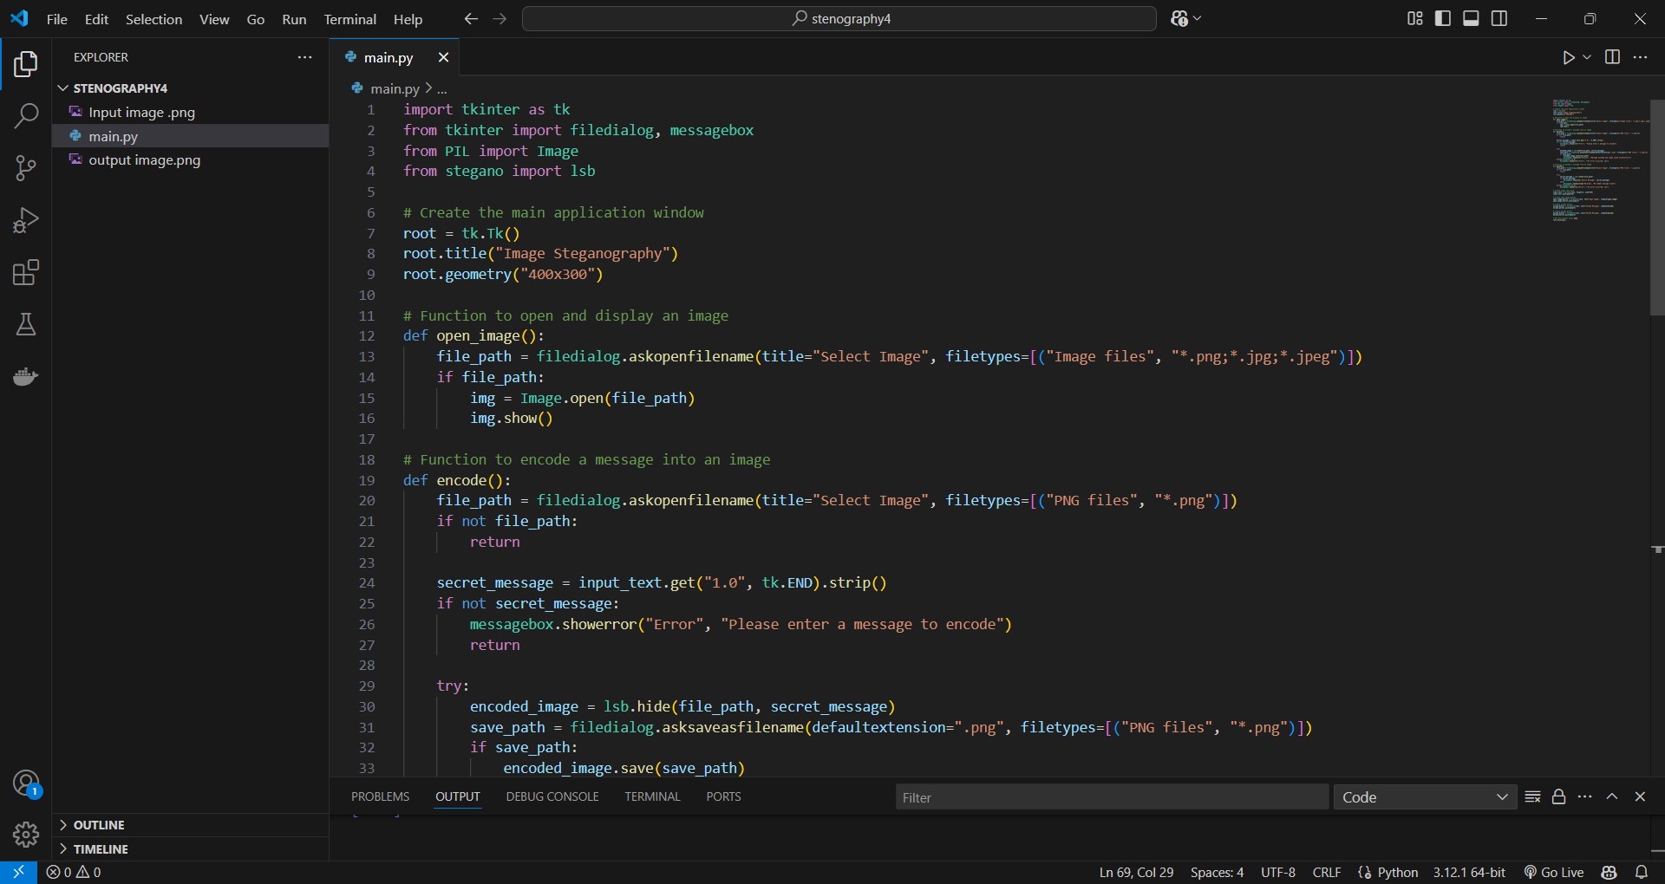


Results
Before
Image
stenography
After
Image
stenography

Slide 8
Conclusion
In an era where digital privacy is increasingly under threat, this project stands as a beacon of innovation and security. By blending the power of Least Significant Bit (LSB) steganography with an intuitive and interactive interface, we’ve created a tool that transforms ordinary images into invisible carriers of confidential information. The simplicity of the user experience, combined with the sophistication of the underlying technique, makes this project a perfect balance of accessibility and security. As technology continues to advance, this work paves the way for future enhancements in secure communication, offering endless possibilities for safeguarding sensitive data in a seamless and unobtrusive manner.

Slide 9
GitHub Link
https://github.com/Abhishek-benchspace/AICTE-Project-Secure-Data-Hiding-in-Image-Using-Steganography
Description: This project implements Least Significant Bit (LSB) steganography to securely hide and extract secret messages within image files.
Repository Contents:
📂 Source Code – main.py script for encoding and decoding hidden messages using Python and the stegano library.
📂 Sample Images C "Input image.png" and "output image.png" used for testing the steganography process. 📂 README.md – Project description and usage instructions. 📂 .gitignore – File to manage ignored files in the repository.
📂 AICTE Project Steganography PPT – PPT slides summarizing the project.

Slide 10
Future scope(optional)
Advanced Techniques: Explore more sophisticated steganography methods like DCT or DWT to enhance security.
Encryption Integration: Combine steganography with encryption for dual-layer protection.
Support for Multimedia: Extend the tool to support audio and video file steganography.
Steganalysis Resistance: Implement countermeasures to prevent detection through steganalysis tools.
Cross-Platform Compatibility: Enhance the GUI to work across different operating systems seamlessly.

Slide 11
THANK YOU

